Slide 1
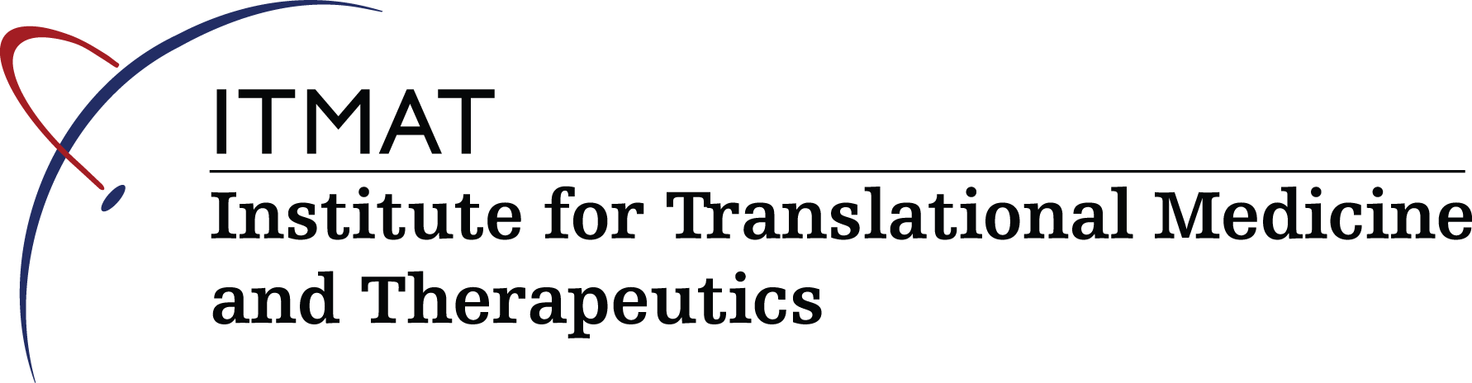
Opportunities to Pursue a Clinical and Translational Career at Penn
Emma A. Meagher, MD
Vice Dean for Clinical Research & Chief Clinical Research Officer

Slide 2
What does the Education Pathway look like?
In parallel or in sequence?
Medical School
Residency & Subspecialty Training
Research Training -Apprentice Model or Formalized Program
Non-Research Training -MBA, JD, etc

Slide 3
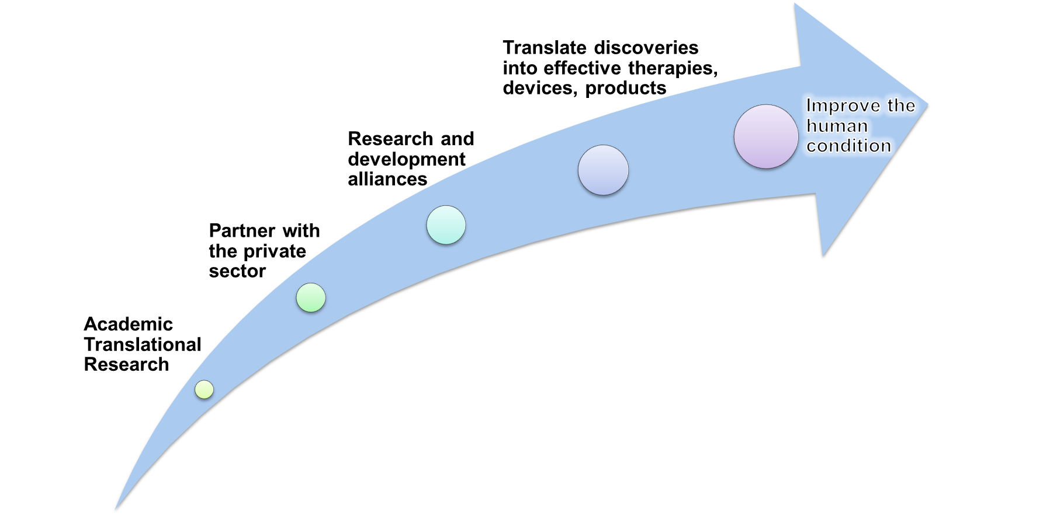
The Shifting Interface of Academia and Healthcare
Integrating the translation of discovery into medical education
The Learning Health Care System
  Large Data
  Academic Partnerships/Consortia
  Team Science
  Science of Healthcare Economics
  Science of healthcare operations on outcomes

Slide 4
Definition of Clinical Research
The Evolution of the Research Landscape
**The Learning Health Care System

Slide 5
Career Planning - Academic Tracks
Academic Clinician
Clinician Educator
Research
Tenure

Slide 6
Evolution from Reliance to Independence
Provide the training
Provide the funding
Provide the mentoring
Provide the infrastructure
Meagher EA,. Clin Transl Sci. 2011 Oct;4(5):353-8.

Slide 7
Levels of Engagement for
Translational Research Education
Masters Programs
Certificate Programs
Introduction to Clinical and Translational Research

Slide 8
MTR 510: Intro to Clinical & Translational Research
Course Director: Emma Meagher, MD
Offered Fall Term, M/W, 4:00 -5:30 PM
Open to nondegree students
Module 1: Research Methods & Protocol Development
Module 2: Regulatory Environment for Clinical Trials.
Upon completion, students should have a strong foundation in the fundamentals of clinical research and should be able to apply contemporary research tools to clinically relevant areas of investigation.
Notes:
Updated from InPORT

Slide 9
Certificate in Clinical Research - Epidemiology
Requirements
  4 courses totaling a minimum of 3 course units which must include:
      Epidemiology research methods/study design
      Biostatistics for epidemiology
      Practical applications of Epidemiology Research
      Scientific and Ethical research conduct
  Completion of 2 online Collaborative Institutional Training Initiative (CITI) units
Two pathways:
  Non-credit - only available to Penn
  Credit - Staff and faculty or anyone external to Penn.
For More Information:
https://www.med.upenn.edu/cceb/edu/nd/certificate.shtml
ccebcert@mail.med.upenn.edu

Slide 10
Master of Science in Clinical Epidemiology
Primary objectives is to produce a cadre of skilled investigators trained to conduct epidemiology studies.
Designed to be completed in two to three years of full-time study (14 c.u. required)
    Generally, first year students devote their time to the "core courses" and the writing of their thesis protocol
    In the 2nd and 3rd years of study students complete electives and conduct their thesis projects.
General Inquiries: Jennifer Kuklinski, jkuklins@mail.med.upenn.edu
Admissions Inquiries: ceuapps@mail.med.upenn.edu
http://www.cceb.med.upenn.edu/master-science-clinical-epidemiology-msce

Slide 11
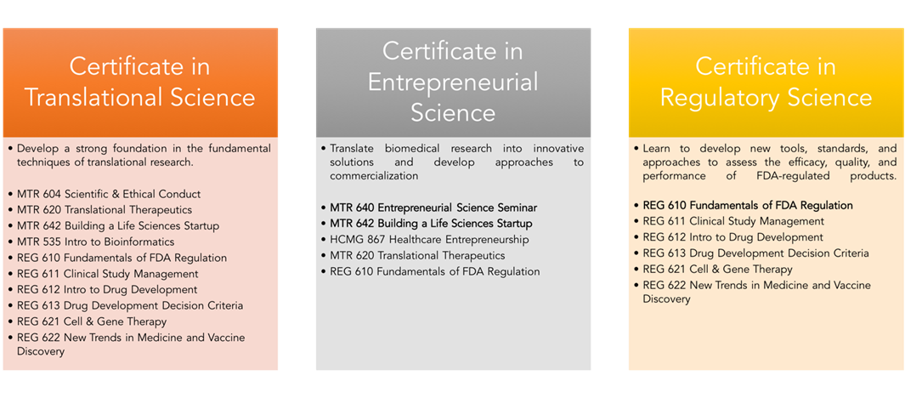
ITMAT Certificate Program
In-depth training in Clinical and Translational Science
Certificates in Translational, Entrepreneurial, and Regulatory Science
Requirements
  4 c.u. of coursework, one-year engagement in CTR research project, and active mentorship
  MTR 510 and MTR 600 are required for all certificates
  Elective courses are based on selected certificate
For more information and to apply: http://www.itmat.upenn.edu/certificate/

Slide 12
Master of Science in Translational Research
Provide training in translational research by combining didactic and experiential learning in a structured degree program
  Prepare students to think critically to pose and answer research questions
  Provide instruction in grant and manuscript writing
  Prepare students to execute research proposals
  Prepare students to evaluate the translational impact of their research
Curriculum
  80% of time on the research project
  Didactic course work, wet and/or dry lab based learning
Career development and mentoring
  Team Mentoring Approach
  Professional Development Core
Curriculum
Research
Project
Career Development
& Mentorship

Slide 13
MTR Concentrations
Discovery: For students who are connecting the basic science of disease with human medicine. Projects may be proof of concept in cell or animal models or human samples.
Core Courses
Discovery
Entrepreneurial Science
Biomedical Informatics
Translational Therapeutics and Regulatory Science
Biomedical Informatics: For students who are adopting informatics methodologies to develop and test their own hypotheses.
Entrepreneurial Science: For students who aim to navigate both business and academic environments as you conduct research and consider commercialization opportunities.
Translational Therapeutics: For students who are testing discoveries for clinical effect. Projects may be first in humans, phase 1, or assessing the safety, efficacy, quality, and performance of regulated products.

Slide 14
From Reliance to Independence
Provide the training
Provide the funding
Provide the mentoring
Provide the infrastructure

Slide 15
ITMAT Community Education
Research Mentor Training
  To develop mentoring skills in Penn and CHOP research faculty
Junior Investigator Symposium
  Late stage post docs/clinical fellows & early stage faculty at Penn and CHOP focused on successful career strategies for a career in CTS
Clinical and Translational Research 101
  To introduce new residents and fellows at Penn and CHOP to the CTS landscape on campus
Career development workshops with Pharma
CTS Professional Staff
  Masters in Regulatory Affairs

Slide 16
From Reliance to Independence
Provide the training
Provide the funding
Provide the mentoring
Provide the infrastructure

Slide 17
Protecting time for students to train
Maintaining 80% protected time and securing tuition support
  Departmental T32s
  ITMAT Fellowships
  Internal Foundation Grants
  NIH KL2 and TL1 Awards
Notes:
Added from may trustees presentation

Slide 18
From Reliance to Independence
Provide the training
Provide the funding
Provide the mentoring
Provide the infrastructure
.

Slide 19
Infrastructural Support – Enabling CTS
Necessary support
Monitoring/ Compliance Program
IT Infrastructure
Clinical Trials Contracting
Sponsor IND/IDE Support
Clinical Research Operations
Community Engagement
Financial Operations
Professional development core
Tech Transfer / Business development

